Slide 1
◆
HACKATHON 2026
Treasury AI
Reconciliation that explains itself.
An autonomous treasury analyst for small and mid-sized businesses — it reads documents, matches payments across currencies, catches fraud, and explains every discrepancy.

Slide 2




MEET THE TEAM
Our Team
A passionate team of innovators building the future of AI-powered treasury management.
Infrastructure Engineer
Frontend Engineer
AI Engineer
Project Lead | AI Strategy
05

Slide 3
THE PROBLEM
SMEs reconcile money by hand — and it costs them.
Cross-border chaos
Manual reconciliation
Payments arrive in different currencies; FX spreads and bank fees distort every amount.
Hours each week spent eyeballing spreadsheets against bank statements.
Invoice mismatches
Fraud slips through
Missing references and partial payments turn matching into guesswork.
Duplicate invoices and unknown-vendor payments go unnoticed until it is too late.
Every hour spent reconciling is an hour not spent running the business.
02

Slide 4
THE SOLUTION
An autonomous treasury analyst.
Instead of checking spreadsheets by hand, your team gets an AI agent that runs the whole reconciliation cycle — and shows its work.
→
→
→
→
1
2
3
4
5
Reads financial documents
Matches payments across currencies
Detects fraud & anomalies
Explains every discrepancy
Generates audit-ready reports
THE PRINCIPLE
The matching is deterministic, auditable code. The AI only explains and advises — it never decides the numbers. An analyst, not a calculator.
03

Slide 5
CORE CAPABILITIES
Seven capabilities, one pipeline.
Smart Document Upload
AI Data Extraction
Reconciliation Engine
Invoices and bank statements as CSV, Excel or digital PDF.
Pulls invoice no., amount, currency, vendor, reference, date.
Classifies matched, partial, suspicious and unmatched.
AI Reasoning
Fraud & Risk Detection
Executive Dashboard
Plain-English explanation of every mismatch and decision.
Flags duplicates, abnormal amounts, unknown vendors, patterns.
KPIs, confidence scores, fraud alerts and analytics charts.
Auto Audit Report Generation One click produces a professional PDF — executive summary, anomaly log and full audit trail.
7
04

Slide 6
PRODUCT EXPERIENCE
A guided analysis workflow.
Treasury AI is built as a clear step-by-step process — no training needed.
01
02
03
04
05
Start
Upload
Process
Results
History
Open the workspace and begin a new analysis.
Drop in an invoices file and a bank statement.
The engine reconciles and scans for risk instantly.
Overview, reconciliation, risk and audit — all in tabs.
Every scan is saved and can be reopened any time.
Honest scope: scan history is session-based today; user accounts and persistent storage are the next milestone on the roadmap.
05

Slide 7
THE AI LAYER
How the AI works — powered by Chutes AI.
Treasury AI uses a large language model served by Chutes AI. Crucially, the AI never touches the math — it interprets results the engine has already computed.
WHAT THE AI DOES
WHAT THE AI NEVER DOES
✓
Explains why a transaction was flagged
✕
Decide whether two records match
✓
Writes the step-by-step reasoning chain
✕
Calculate amounts, deltas or totals
✓
Assesses risk and recommends an action
✕
Assign a reconciliation status
✓
Answers questions in the chat copilot
✕
Change any number in the audit trail
BUILT TO FAIL SAFE
If Chutes AI is slow or unavailable, every AI feature falls back to a deterministic, rule-based explanation. The system — and the demo — never breaks.
06

Slide 8
AI REASONING
Every flag, explained.
Click Explain on any transaction and Treasury AI opens a full structured reasoning breakdown.
Why it was flagged
The verdict in plain language — what triggered this status.
1
Reasoning chain
The numbered logic steps the system followed to reach it.
2
Risk analysis
The financial or fraud exposure this transaction carries.
3
Recommended action
The concrete next step a treasurer should take.
4
Confidence breakdown
How strong the evidence is — shown as a calibrated score.
5
07

Slide 9
AI COPILOT
Ask Treasury AI anything.
A built-in conversational assistant that knows the data of the scan you are looking at — answers are grounded in real numbers, not generic advice.
TREASURY AI COPILOT
WHAT YOU CAN ASK
Why is INV-1604 risky?
Why is a specific invoice flagged?
INV-1604 is a 95,000 USD payment to Blackstone Holdings with no reference. The amount is far above the batch average and the missing reference weakens the audit trail — recommend holding payment for review.
How many invoices matched this scan?
Which invoices are still unmatched?
Summarise the risk alerts for me.
Falls back to a deterministic answer if the AI is offline — the demo never breaks.
08

Slide 10
FRAUD DETECTION & REPORTING
Catches risk, proves the trail.
RULE-BASED FRAUD ENGINE
ONE-CLICK AUDIT REPORT
Duplicate invoices
Every scan exports a professional PDF audit report, ready to hand to an accountant or auditor.
Same vendor, amount and reference billed twice.
Unknown merchants
✓
Executive summary
Outgoing payments with no matching invoice.
Missing references
✓
Key reconciliation metrics
Large payments with a weak audit trail.
✓
Per-invoice detail with AI notes
Abnormal amounts
✓
Anomaly & risk log
Statistical outliers far above the batch norm.
✓
Full audit trail
Suspicious patterns
Round-number transfers and vendor anomalies.
✓
Methodology & disclaimer
09

Slide 11
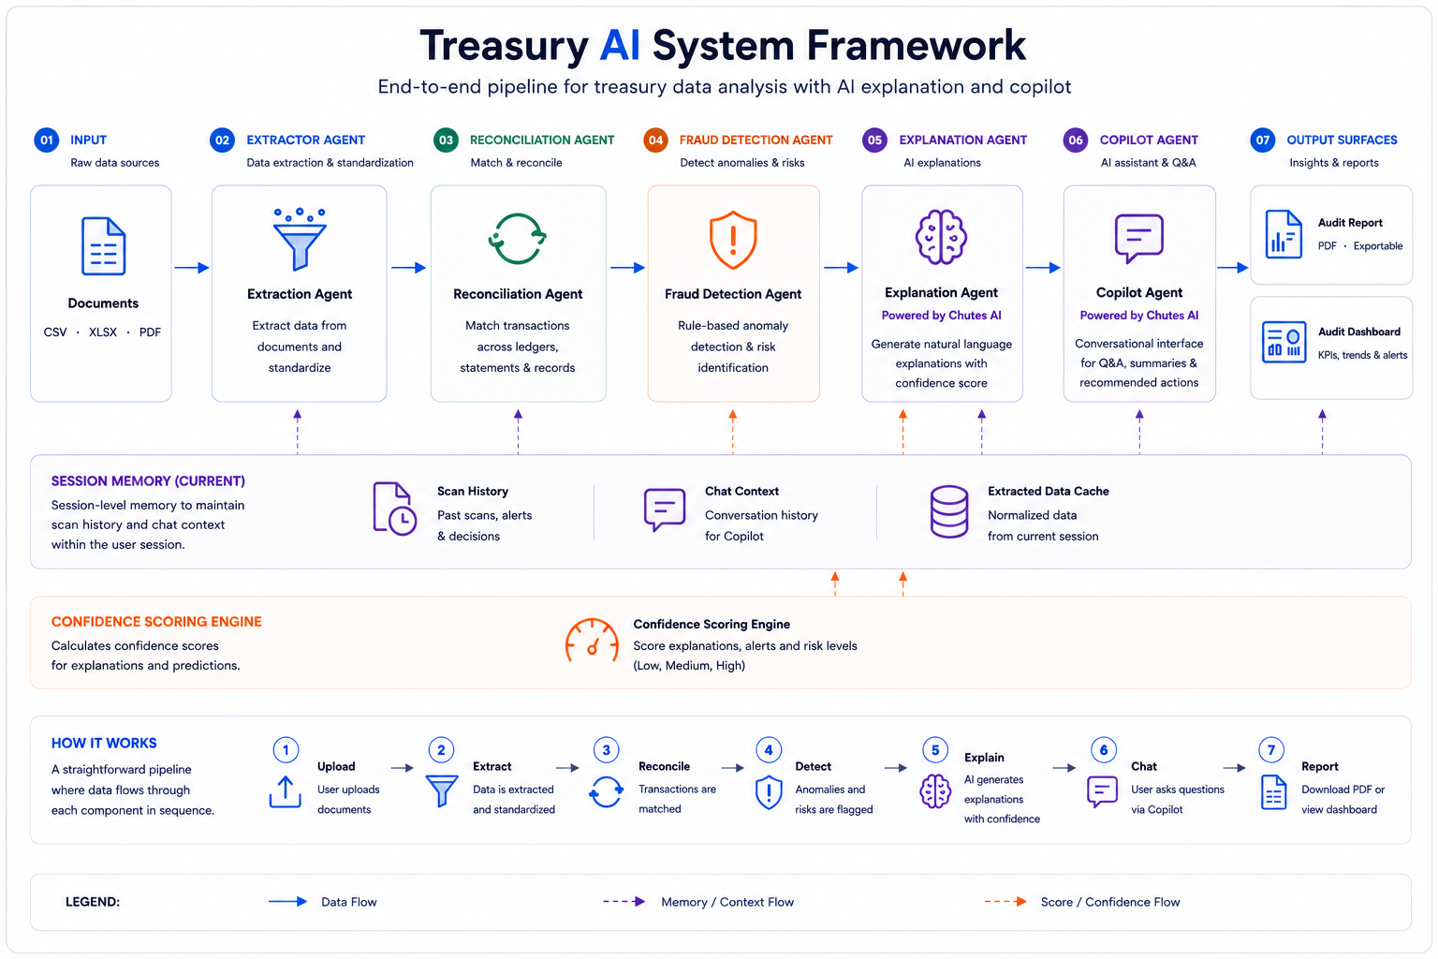
SYSTEM ARCHITECTURE
The full agent framework.
10

Slide 12
◆
TREASURY AI
Thank you
Reconciliation that explains itself.
Autonomous
Auditable
Cross-currency
Fraud-aware

